Slide 1
Multilayer Perceptrons (PART 1)

Slide 2
Introduction
Multilayer feedforward networks
Input layer (a set or source nodes)
One or more hidden layers (computation nodes)
Output layer (computation nodes)
Signal propagates through network in a forward direction layer by layer
Such networks are called multilayer perceptrons (MLPs)
They have been successfully applied to solve diverse difficult problems by training them in a supervised manner using error back-propagation algorithm

Slide 3
Chapter Organization
Back Propagation Learning
MLPs as Pattern Recognizers
Error Surface
Performance
Back Propagation Learning (revisited)
Supervised Learning as an optimization problem
Convolutional Networks

Slide 4
Chapter Organization
Back Propagation Learning
MLPs as Pattern Recognizers
Error Surface
Performance
Back Propagation Learning (revisited)
Supervised Learning as an optimization problem
Convolutional Networks

Slide 5
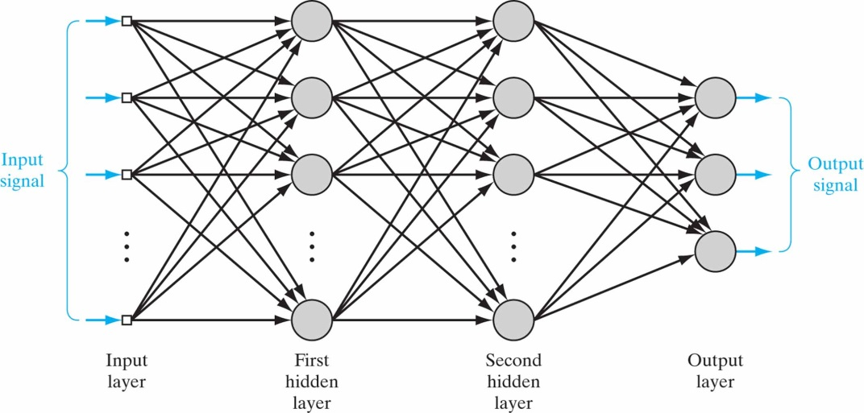
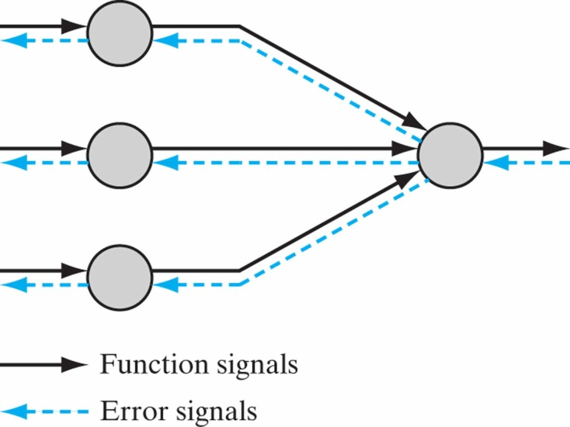
Back Propagation Learning Some Preliminaries
2 kinds of signals
Function signals
Error signals
Each neuron is involved in 2 calculations
Computation of function signal
Computation of an estimate of the gradient vector (needed for backward pass)

Slide 6
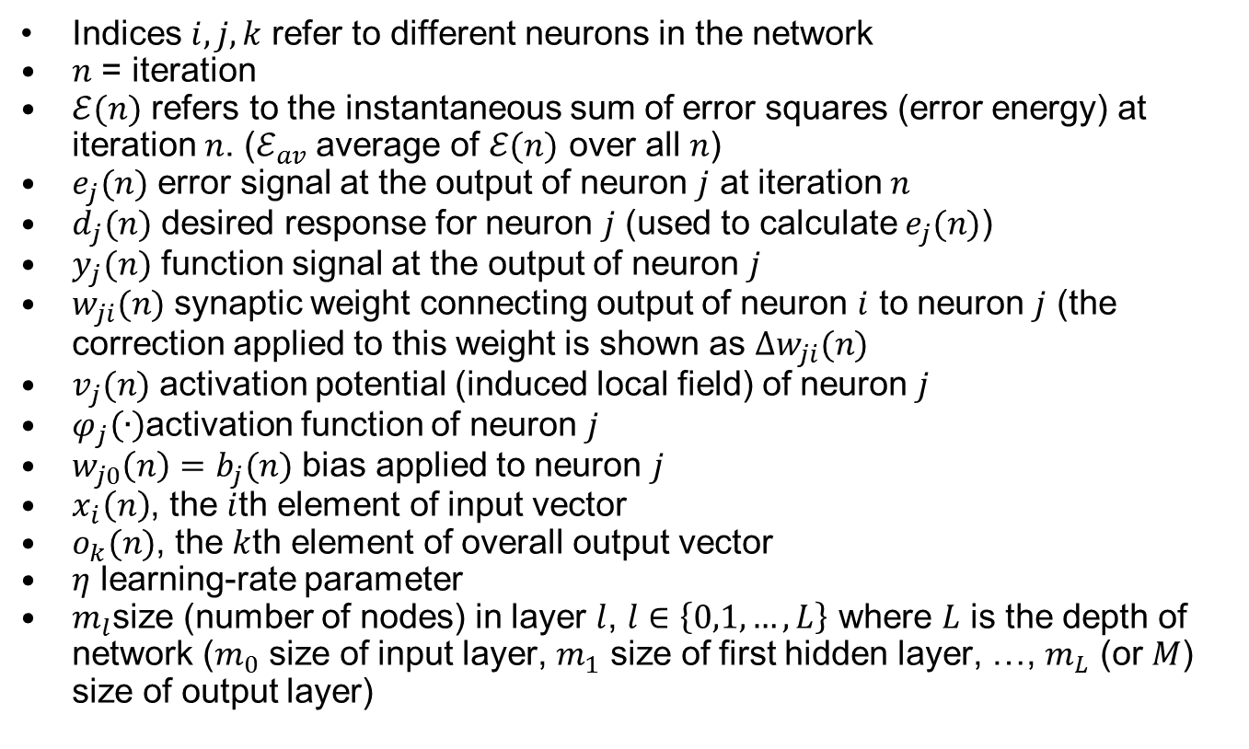
Back Propagation Learning Summary of Notation
Indices $i,j,k$ refer to different neurons in the network
$n$ = iteration
$ℰ(n)$ refers to the instantaneous sum of error squares (error energy) at iteration $n$. ($ℰ_{av}$ average of $ℰ(n)$ over all $n$)
$e_{j}(n)$ error signal at the output of neuron $j$ at iteration $n$
$d_{j}(n)$ desired response for neuron $j$ (used to calculate $e_{j}(n)$)
$y_{j}(n)$ function signal at the output of neuron $j$
$w_{ji}(n)$ synaptic weight connecting output of neuron $i$ to neuron $j$ (the correction applied to this weight is shown as $Δw_{ji}(n)$
$v_{j}(n)$ activation potential (induced local field) of neuron $j$
$φ_{j}\left(∙\right)$activation function of neuron $j$
$w_{j0}\left(n\right)=b_{j}(n)$ bias applied to neuron $j$
$x_{i}\left(n\right)$, the $i$th element of input vector
$o_{k}(n)$, the $k$th element of overall output vector
$η$ learning-rate parameter
$m_{l}$size (number of nodes) in layer $l$, $l∈\left\{0,1,…,L\right\}$ where $L$ is the depth of network ($m_{0}$ size of input layer, $m_{1}$ size of first hidden layer, …, $m_{L}$ (or $M$) size of output layer)

Slide 7
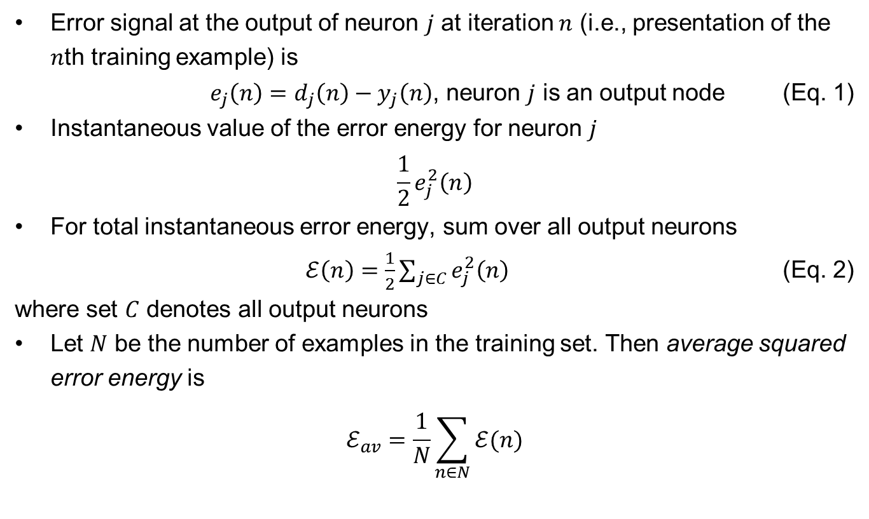
Back-Propagation Algorithm
Error signal at the output of neuron $j$ at iteration $n$ (i.e., presentation of the $n$th training example) is
$e_{j}\left(n\right)=d_{j}\left(n\right)−y_{j}\left(n\right)$, neuron $j$ is an output node (Eq. 1)
Instantaneous value of the error energy for neuron $j$
$$\frac{1}{2}e_{j}^{2}\left(n\right)$$
For total instantaneous error energy, sum over all output neurons
$ℰ\left(n\right)=\frac{1}{2}\sum_{j∈C}{e_{j}^{2}\left(n\right)}$ (Eq. 2)
where set $C$ denotes all output neurons
Let $N$ be the number of examples in the training set. Then average squared error energy is
$$ℰ_{av}=\frac{1}{N}\sum_{n∈N}{ℰ(n)}$$

Slide 8
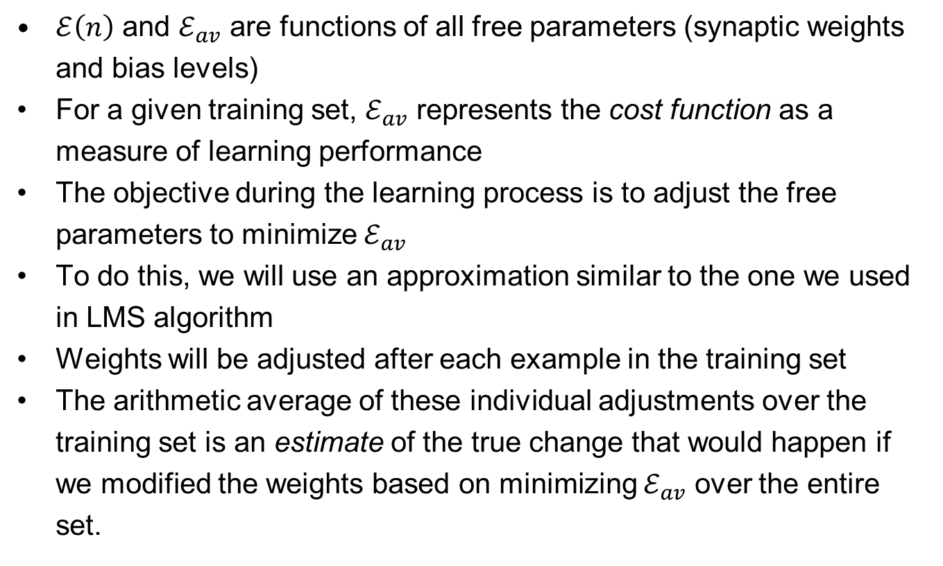
Back-Propagation Algorithm
$ℰ\left(n\right)$ and $ℰ_{av}$ are functions of all free parameters (synaptic weights and bias levels)
For a given training set, $ℰ_{av}$ represents the cost function as a measure of learning performance
The objective during the learning process is to adjust the free parameters to minimize $ℰ_{av}$
To do this, we will use an approximation similar to the one we used in LMS algorithm
Weights will be adjusted after each example in the training set
The arithmetic average of these individual adjustments over the training set is an estimate of the true change that would happen if we modified the weights based on minimizing $ℰ_{av}$ over the entire set.

Slide 9
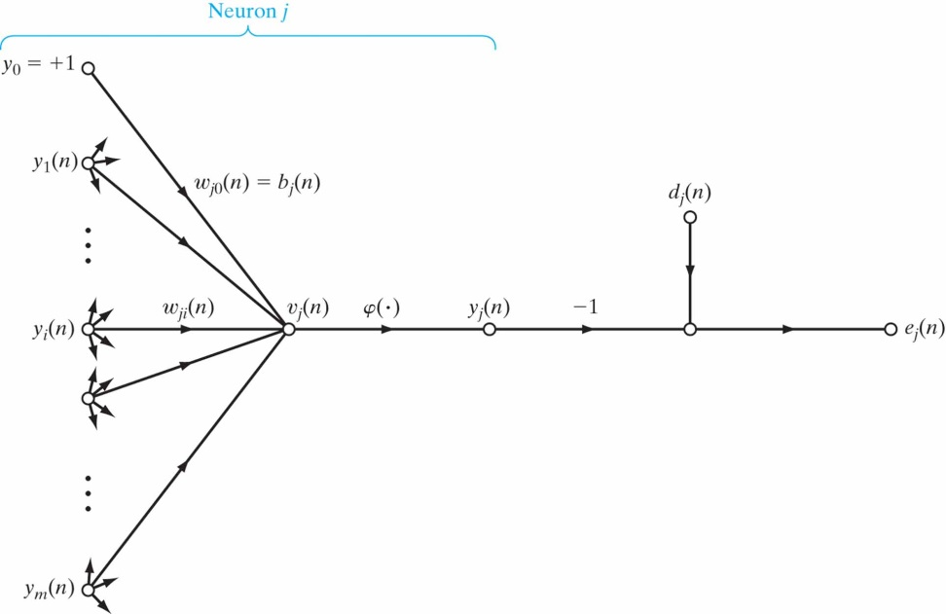
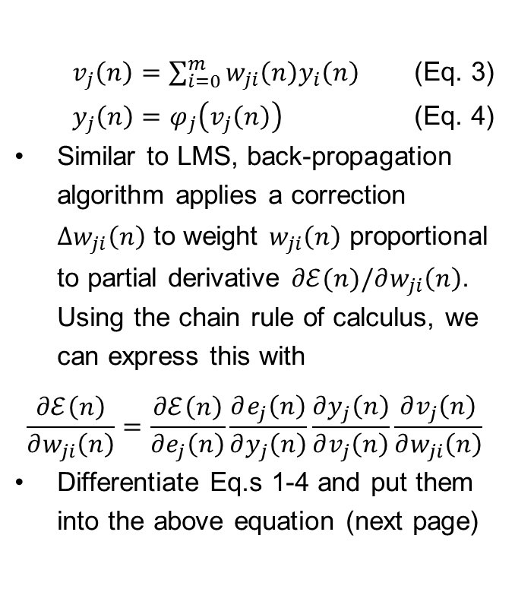
Back-Propagation Algorithm
$v_{j}\left(n\right)=\sum_{i=0}^{m}{w_{ji}\left(n\right)y_{i}\left(n\right)}$ (Eq. 3)
$y_{j}\left(n\right)=φ_{j}\left(v_{j}\left(n\right)\right)$ (Eq. 4)
Similar to LMS, back-propagation algorithm applies a correction $Δw_{ji}\left(n\right)$ to weight $w_{ji}\left(n\right)$ proportional to partial derivative $∂ℰ(n)/∂w_{ji}\left(n\right)$. Using the chain rule of calculus, we can express this with
$$\frac{∂ℰ\left(n\right)}{∂w_{ji}\left(n\right)}=\frac{∂ℰ\left(n\right)}{∂e_{j}\left(n\right)}\frac{∂e_{j}\left(n\right)}{∂y_{j}\left(n\right)}\frac{∂y_{j}\left(n\right)}{∂v_{j}\left(n\right)}\frac{∂v_{j}\left(n\right)}{∂w_{ji}\left(n\right)}$$
Differentiate Eq.s 1-4 and put them into the above equation (next page)

Slide 10
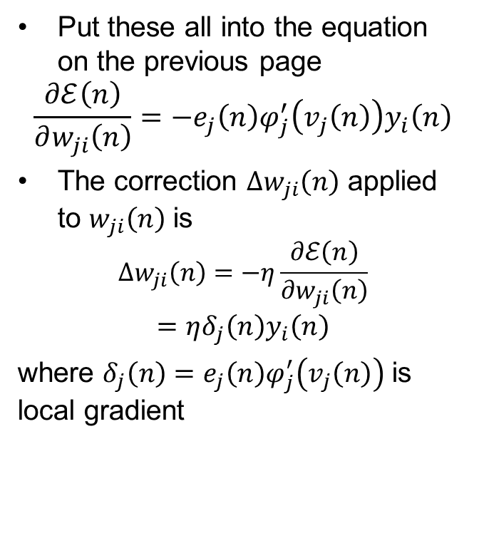
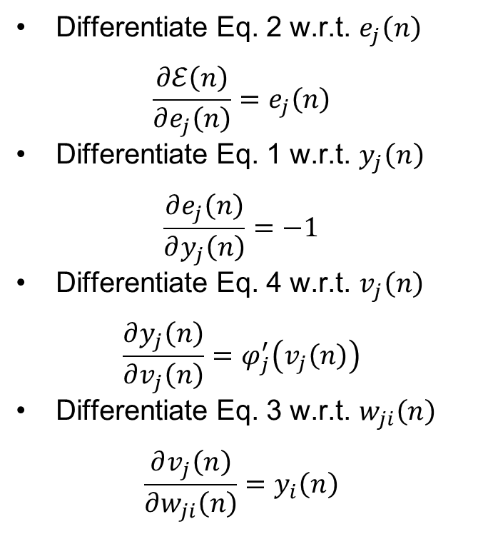
Back-Propagation Algorithm
Differentiate Eq. 2 w.r.t. $e_{j}\left(n\right)$
$$\frac{∂ℰ\left(n\right)}{∂e_{j}\left(n\right)}=e_{j}\left(n\right)$$
Differentiate Eq. 1 w.r.t. $y_{j}\left(n\right)$
$$\frac{∂e_{j}\left(n\right)}{∂y_{j}\left(n\right)}=−1$$
Differentiate Eq. 4 w.r.t. $v_{j}\left(n\right)$
$$\frac{∂y_{j}\left(n\right)}{∂v_{j}\left(n\right)}=φ_{j}^{′}\left(v_{j}\left(n\right)\right)$$
Differentiate Eq. 3 w.r.t. $w_{ji}\left(n\right)$
$$\frac{∂v_{j}\left(n\right)}{∂w_{ji}\left(n\right)}=y_{i}\left(n\right)$$
Put these all into the equation on the previous page
$$\frac{∂ℰ\left(n\right)}{∂w_{ji}\left(n\right)}=−e_{j}\left(n\right)φ_{j}^{′}\left(v_{j}\left(n\right)\right)y_{i}\left(n\right)$$
The correction $Δw_{ji}\left(n\right)$ applied to $w_{ji}\left(n\right)$ is
$$Δw_{ji}\left(n\right)=−η\frac{∂ℰ\left(n\right)}{∂w_{ji}\left(n\right)}$$
$$=ηδ_{j}\left(n\right)y_{i}\left(n\right)$$
where $δ_{j}\left(n\right)=e_{j}\left(n\right)φ_{j}^{′}\left(v_{j}\left(n\right)\right)$ is local gradient

Slide 11
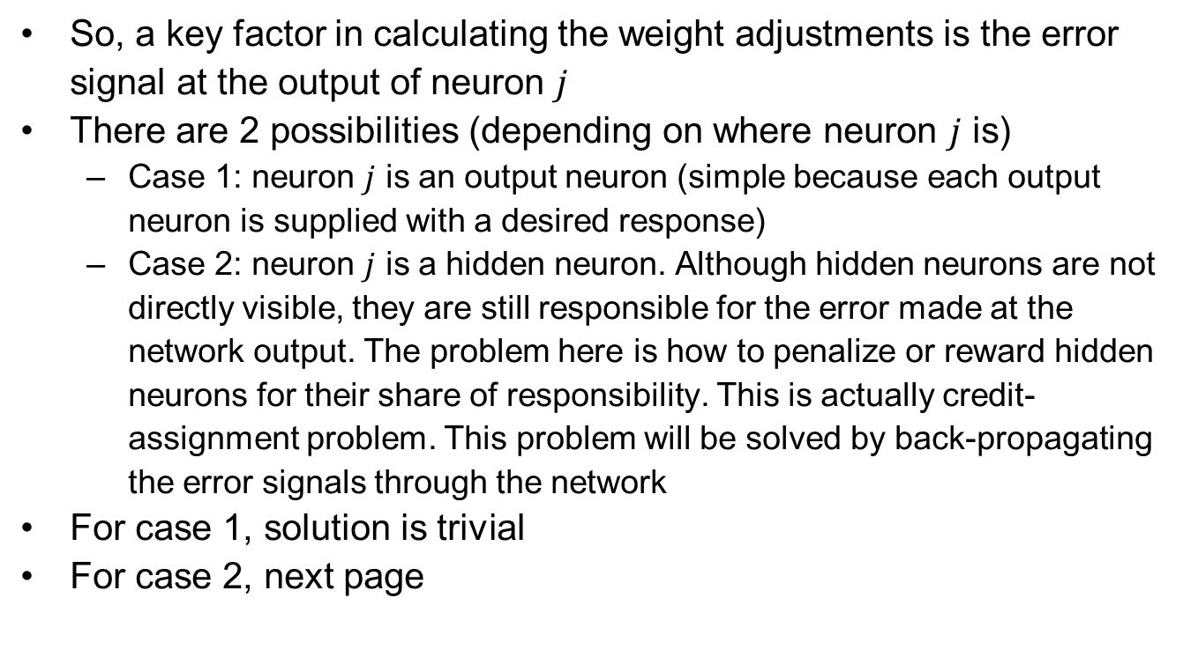
Back-Propagation Algorithm
So, a key factor in calculating the weight adjustments is the error signal at the output of neuron $j$
There are 2 possibilities (depending on where neuron $j$ is)
Case 1: neuron $j$ is an output neuron (simple because each output neuron is supplied with a desired response)
Case 2: neuron $j$ is a hidden neuron. Although hidden neurons are not directly visible, they are still responsible for the error made at the network output. The problem here is how to penalize or reward hidden neurons for their share of responsibility. This is actually credit-assignment problem. This problem will be solved by back-propagating the error signals through the network
For case 1, solution is trivial
For case 2, next page

Slide 12
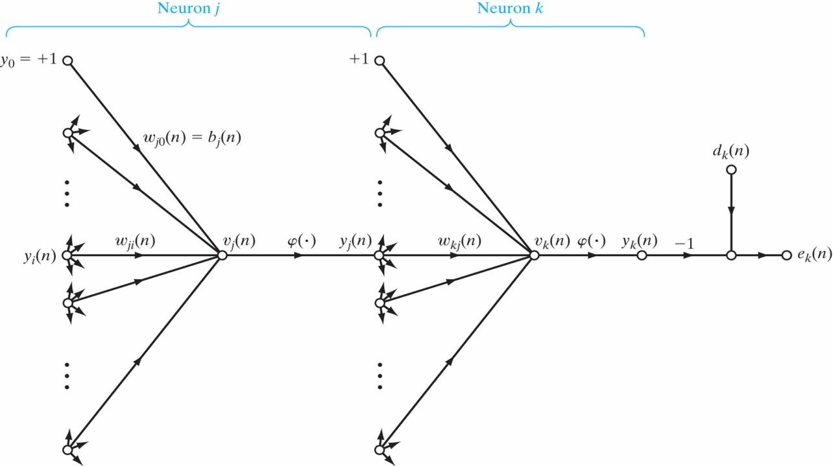
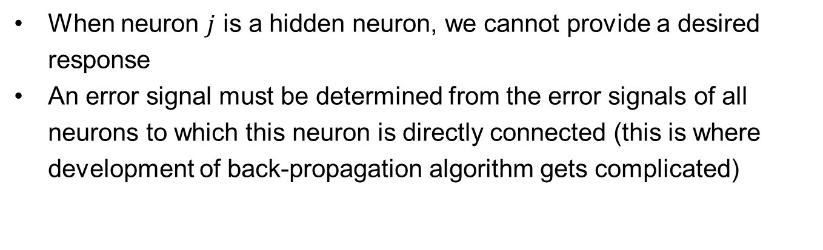
Back-Propagation Algorithm
When neuron $j$ is a hidden neuron, we cannot provide a desired response
An error signal must be determined from the error signals of all neurons to which this neuron is directly connected (this is where development of back-propagation algorithm gets complicated)

Slide 13
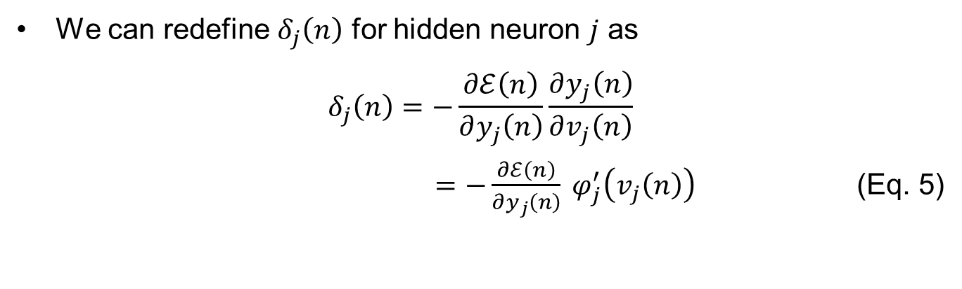
Back-Propagation Algorithm
We can redefine $δ_{j}\left(n\right)$ for hidden neuron $j$ as
$$δ_{j}\left(n\right)=−\frac{∂ℰ\left(n\right)}{∂y_{j}\left(n\right)}\frac{∂y_{j}\left(n\right)}{∂v_{j}\left(n\right)}$$
$=−\frac{∂ℰ\left(n\right)}{∂y_{j}\left(n\right)} φ_{j}^{′}\left(v_{j}\left(n\right)\right)$ (Eq. 5)

Slide 14
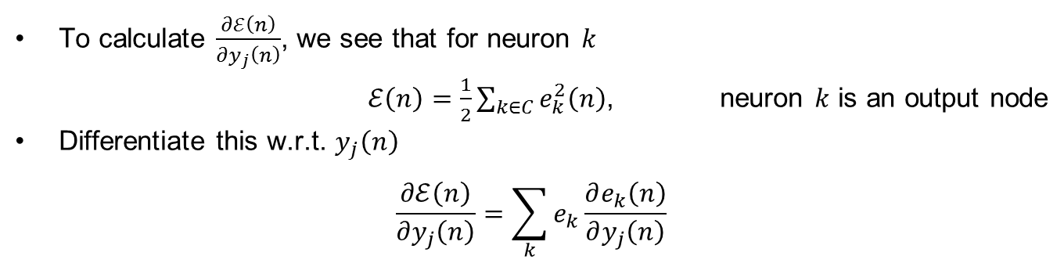
Back-Propagation Algorithm
To calculate $\frac{∂ℰ\left(n\right)}{∂y_{j}\left(n\right)}$, we see that for neuron $k$
$ℰ\left(n\right)=\frac{1}{2}\sum_{k∈C}{e_{k}^{2}\left(n\right)}$, neuron $k$ is an output node
Differentiate this w.r.t. $y_{j}\left(n\right)$
$$\frac{∂ℰ\left(n\right)}{∂y_{j}\left(n\right)}=\sum_{k}{e_{k}\frac{∂e_{k}\left(n\right)}{∂y_{j}\left(n\right)}}$$

Slide 15
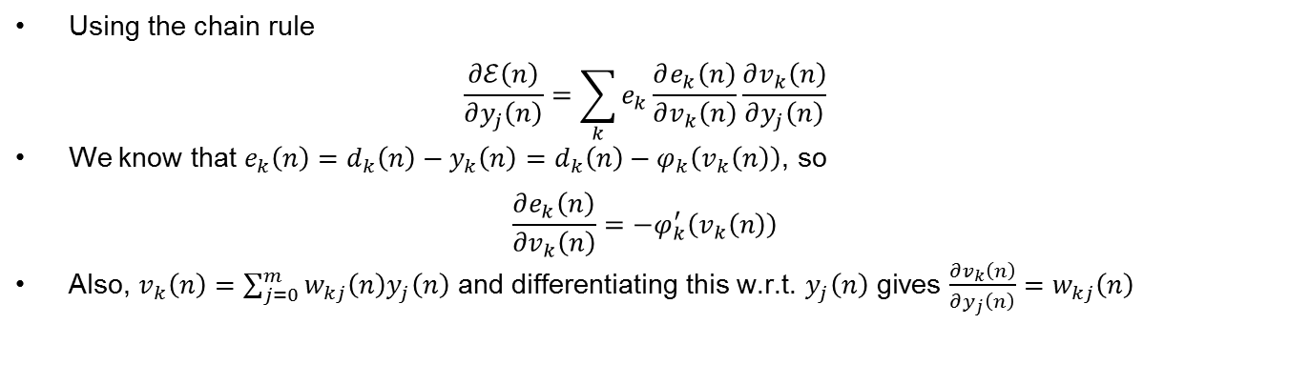
Back-Propagation Algorithm
Using the chain rule
$$\frac{∂ℰ\left(n\right)}{∂y_{j}\left(n\right)}=\sum_{k}{e_{k}\frac{∂e_{k}\left(n\right)}{∂v_{k}\left(n\right)}\frac{∂v_{k}\left(n\right)}{∂y_{j}\left(n\right)}}$$
We know that $e_{k}\left(n\right)=d_{k}\left(n\right)−y_{k}\left(n\right)=d_{k}\left(n\right)−φ_{k}\left(v_{k}\left(n\right)\right)$, so
$$\frac{∂e_{k}\left(n\right)}{∂v_{k}\left(n\right)}=−φ_{k}^{′}\left(v_{k}\left(n\right)\right)$$
Also, $v_{k}\left(n\right)=\sum_{j=0}^{m}{w_{kj}\left(n\right)y_{j}\left(n\right)}$ and differentiating this w.r.t. $y_{j}\left(n\right)$ gives $\frac{∂v_{k}\left(n\right)}{∂y_{j}\left(n\right)}=w_{kj}\left(n\right)$

Slide 16
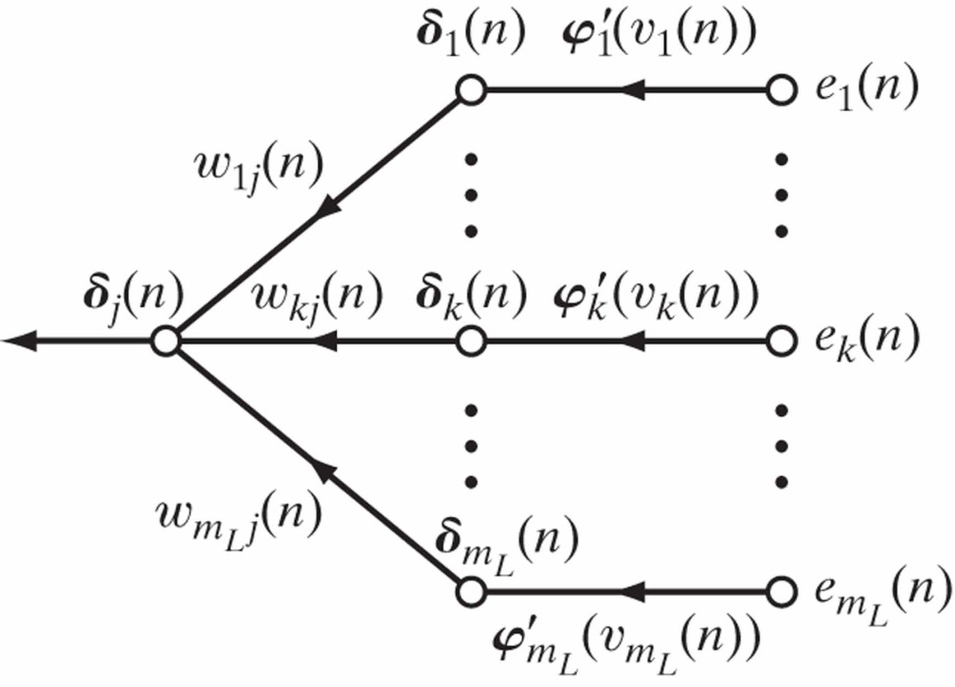
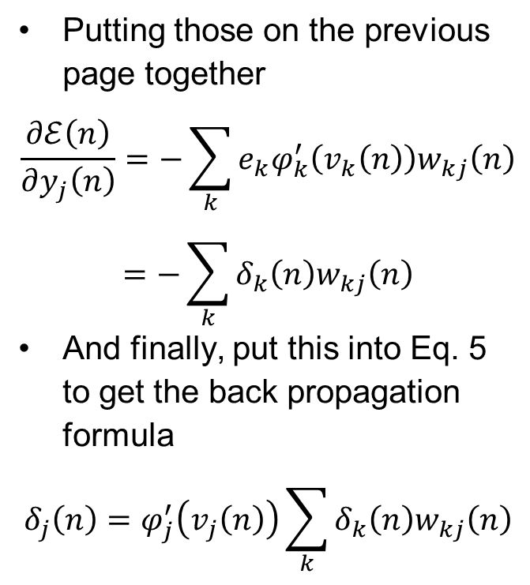
Back-Propagation Algorithm
Putting those on the previous page together
$$\frac{∂ℰ\left(n\right)}{∂y_{j}\left(n\right)}=−\sum_{k}{e_{k}φ_{k}^{′}\left(v_{k}\left(n\right)\right)w_{kj}\left(n\right)}$$
$$=−\sum_{k}{δ_{k}\left(n\right)w_{kj}\left(n\right)}$$
And finally, put this into Eq. 5 to get the back propagation formula
$$δ_{j}\left(n\right)=φ_{j}^{′}\left(v_{j}\left(n\right)\right)\sum_{k}{δ_{k}\left(n\right)w_{kj}\left(n\right)}$$

Slide 17
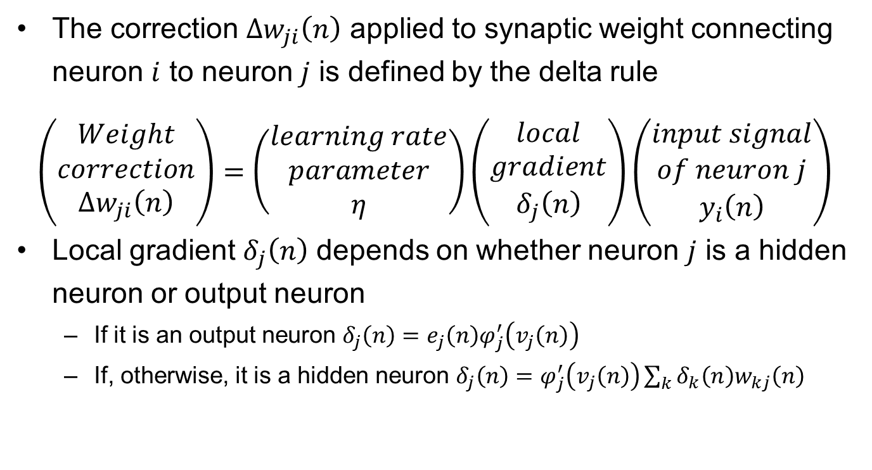
Back-Propagation Algorithm Summary of Derivation
The correction $Δw_{ji}\left(n\right)$ applied to synaptic weight connecting neuron $i$ to neuron $j$ is defined by the delta rule
$$\left(\begin{matrix}Weight \\ correction \\ Δw_{ji}\left(n\right)\end{matrix}\right)=\left(\begin{matrix}learning rate \\ parameter \\ η\end{matrix}\right)\left(\begin{matrix}local \\ gradient \\ δ_{j}\left(n\right)\end{matrix}\right)\left(\begin{matrix}input signal \\ of neuron j \\ y_{i}\left(n\right)\end{matrix}\right)$$
Local gradient $δ_{j}\left(n\right)$ depends on whether neuron $j$ is a hidden neuron or output neuron
If it is an output neuron $δ_{j}\left(n\right)=e_{j}\left(n\right)φ_{j}^{′}\left(v_{j}\left(n\right)\right)$
If, otherwise, it is a hidden neuron $δ_{j}\left(n\right)=φ_{j}^{′}\left(v_{j}\left(n\right)\right)\sum_{k}{δ_{k}\left(n\right)w_{kj}\left(n\right)}$

Slide 18
Back-Propagation Algorithm Two Passes of Computation
Back-propagation algorithm works with 2 passes of computation:
The first (forward pass):
weights remain unchanged and the function signals are computed on a neuron-by-neuron basis.
Begins by first hidden layer taking the system inputs and ends at the output layer by computing the error signal for each output neuron
The second (backward pass):
starts at the output layer by passing error signals leftward through the network

Slide 19
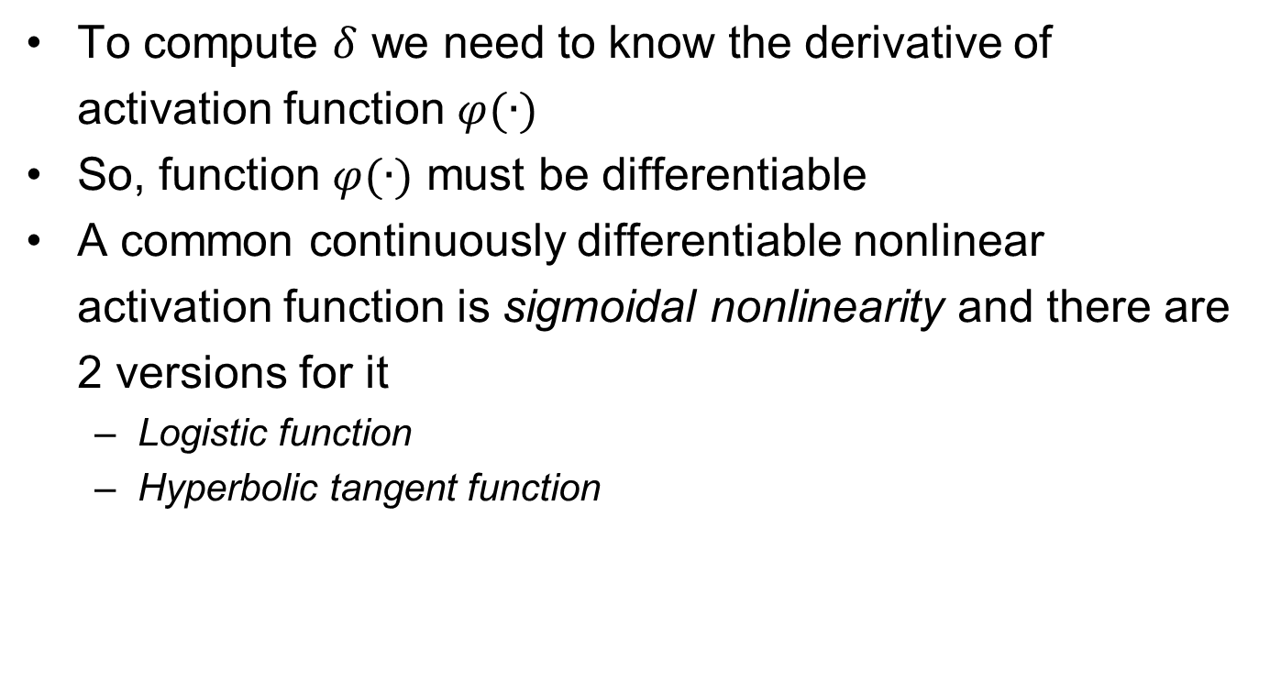
Back-Propagation Algorithm Activation Function
To compute $δ$ we need to know the derivative of activation function $φ(∙)$
So, function $φ(∙)$ must be differentiable
A common continuously differentiable nonlinear activation function is sigmoidal nonlinearity and there are 2 versions for it
Logistic function
Hyperbolic tangent function

Slide 20
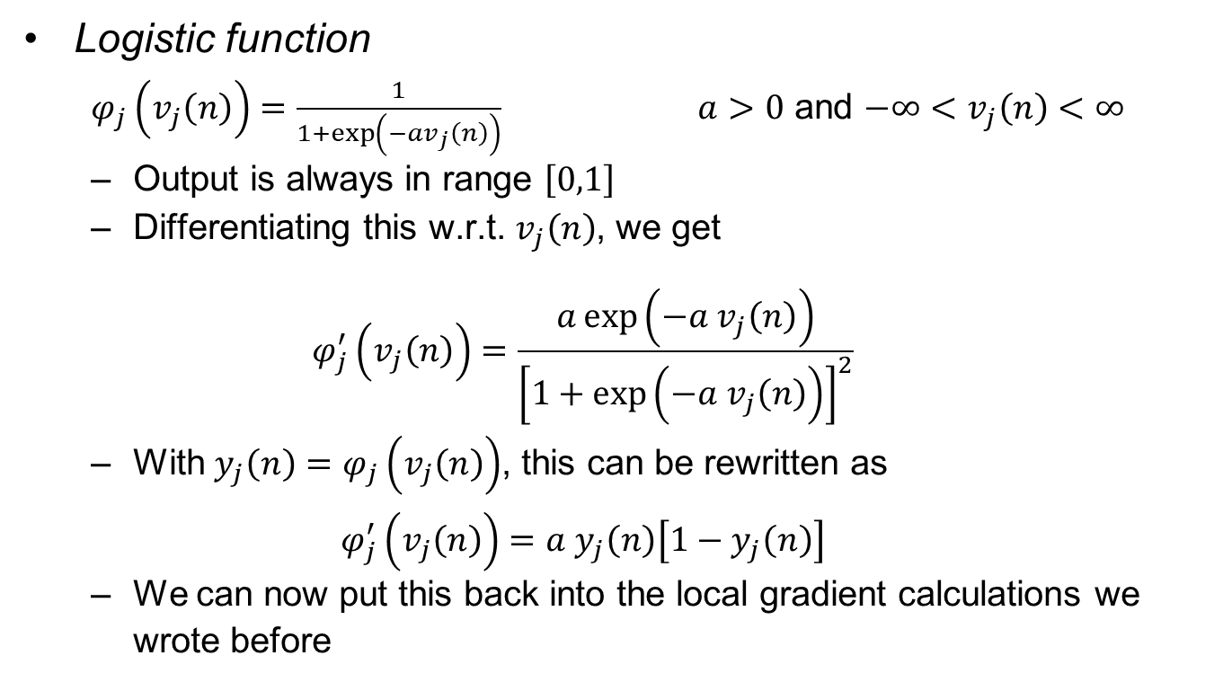
Back-Propagation Algorithm Activation Function
Logistic function
$φ_{j}\left(v_{j}\left(n\right)\right)=\frac{1}{1+\exp\left(−av_{j}\left(n\right)\right)}$ $a>0$ and $−∞<v_{j}\left(n\right)<∞$
Output is always in range $\left[0,1\right]$
Differentiating this w.r.t. $v_{j}\left(n\right)$, we get
$$φ_{j}^{′}\left(v_{j}\left(n\right)\right)=\frac{a\exp\left(−a v_{j}\left(n\right)\right)}{{\left[1+\exp\left(−a v_{j}\left(n\right)\right)\right]}^{2}}$$
With $y_{j}\left(n\right)=φ_{j}\left(v_{j}\left(n\right)\right)$, this can be rewritten as
$$φ_{j}^{′}\left(v_{j}\left(n\right)\right)=a y_{j}\left(n\right)\left[1−y_{j}\left(n\right)\right]$$
We can now put this back into the local gradient calculations we wrote before

Slide 21
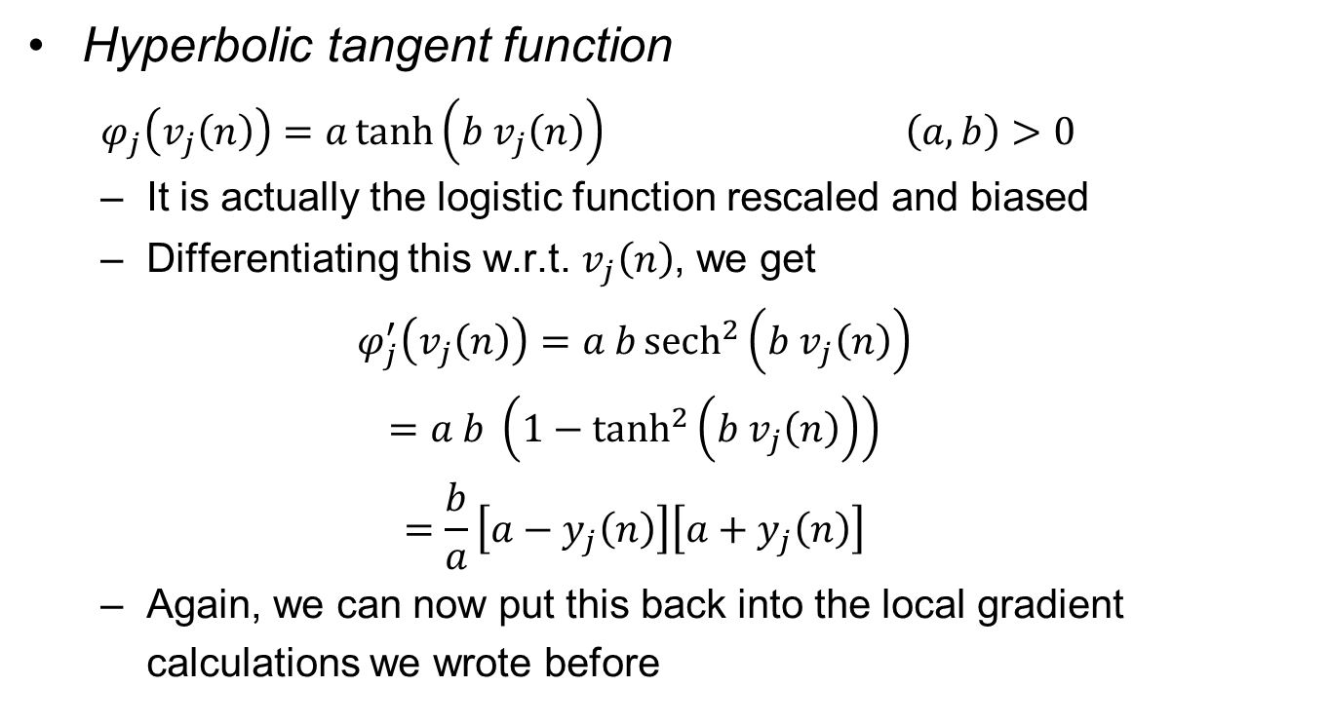
Back-Propagation Algorithm Activation Function
Hyperbolic tangent function
$φ_{j}\left(v_{j}\left(n\right)\right)=a\tanh\left(b v_{j}\left(n\right)\right)$ $\left(a,b\right)>0$
It is actually the logistic function rescaled and biased
Differentiating this w.r.t. $v_{j}\left(n\right)$, we get
$$φ_{j}^{′}\left(v_{j}\left(n\right)\right)=a b{sech}^{2}\left(b v_{j}\left(n\right)\right)$$
$$=a b \left(1−\tanh^{2}\left(b v_{j}\left(n\right)\right)\right)$$
$$=\frac{b}{a}\left[a−y_{j}\left(n\right)\right]\left[a+y_{j}\left(n\right)\right]$$
Again, we can now put this back into the local gradient calculations we wrote before

Slide 22
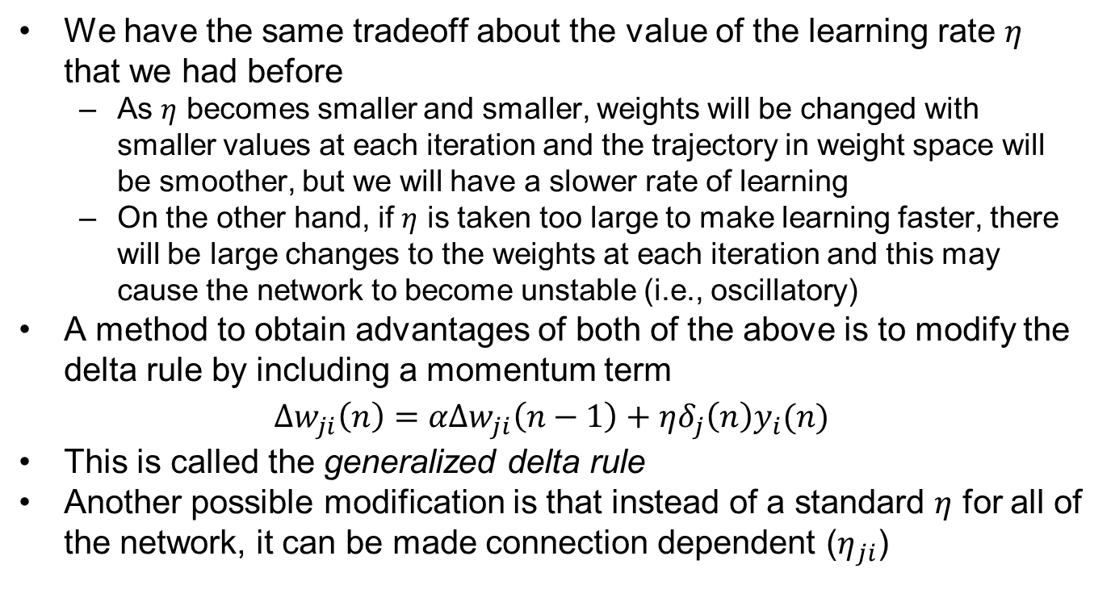
Back-Propagation Algorithm Rate of Learning
We have the same tradeoff about the value of the learning rate $η$ that we had before
As $η$ becomes smaller and smaller, weights will be changed with smaller values at each iteration and the trajectory in weight space will be smoother, but we will have a slower rate of learning
On the other hand, if $η$ is taken too large to make learning faster, there will be large changes to the weights at each iteration and this may cause the network to become unstable (i.e., oscillatory)
A method to obtain advantages of both of the above is to modify the delta rule by including a momentum term
$$Δw_{ji}\left(n\right)=αΔw_{ji}\left(n−1\right)+ηδ_{j}\left(n\right)y_{i}(n)$$
This is called the generalized delta rule
Another possible modification is that instead of a standard $η$ for all of the network, it can be made connection dependent ($η_{ji}$)

Slide 23
Back-Propagation Algorithm Sequential/Batch Modes of Training
In practice, learning happens by presenting a set of training samples to the multilayer perceptron many times
One complete presentation of the entire set is called an epoch
Learning continues in an epoch-by-epoch basis until weights stabilize and average squared error for the entire set converges to some minimum value
It is good practice to randomize the presentation order of training examples between epochs
There are 2 ways back-propagation learning
Sequential mode (online, pattern, or stochastic mode): weights are updated after each sample (we assumed this mode when deriving and explaining the algorithm)
Batch mode: weight updating is done after all samples are presented (changes to equations explained on the next slide)

Slide 24
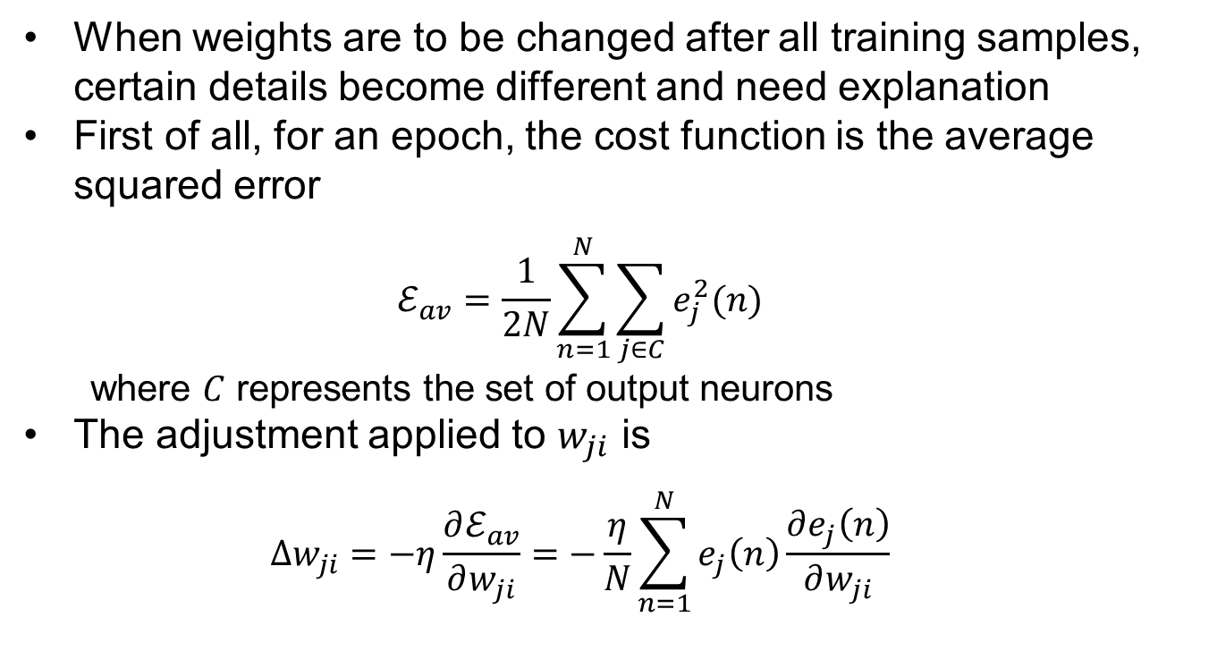
Back-Propagation Algorithm Batch Mode of Training
When weights are to be changed after all training samples, certain details become different and need explanation
First of all, for an epoch, the cost function is the average squared error
$$ℰ_{av}=\frac{1}{2N}\sum_{n=1}^{N}{\sum_{j∈C}{e_{j}^{2}(n)}}$$
where $C$ represents the set of output neurons
The adjustment applied to $w_{ji}$ is
$$Δw_{ji}=−η\frac{∂ℰ_{av}}{∂w_{ji}}=−\frac{η}{N}\sum_{n=1}^{N}{e_{j}\left(n\right)\frac{∂e_{j}\left(n\right)}{∂w_{ji}}}$$

Slide 25
Back-Propagation Algorithm Comparing Sequential/Batch Modes
Sequential mode requires less local storage for each synaptic connection
Moreover, if training samples are presented in a random order, our search in weight space becomes stochastic in nature (less likely to be trapped in a local minimum)
On the other hand, this stochastic nature of sequential mode makes it difficult to establish theoretical conditions for the convergence of the algorithm
Use of batch mode provides an accurate estimate of the gradient vector therefore, convergence to a local minimum is guaranteed under simple conditions
Batch mode is easier to parallelize
When data set is large and redundant (contains several copies of some examples), unlike batch mode, sequential mode takes advantage of this situation
In summary, despite having several disadvantages, sequential mode is popular for two main reasons
It is simple to implement
It provides effective solutions to large and difficult problems

Slide 26
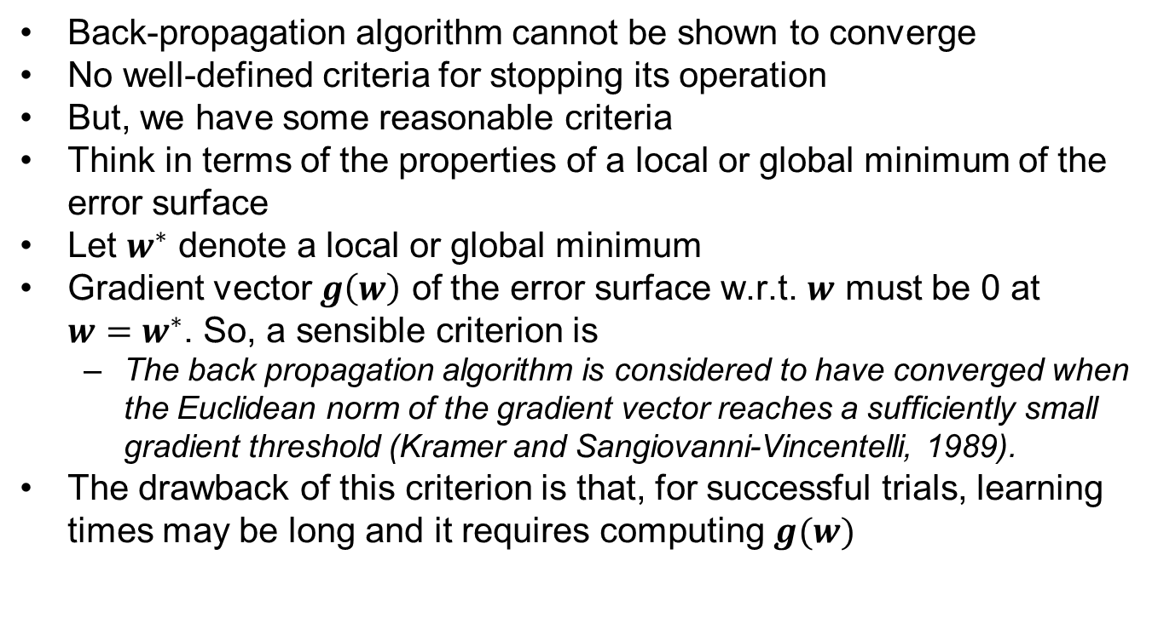
Back-Propagation Algorithm Stopping Criteria
Back-propagation algorithm cannot be shown to converge
No well-defined criteria for stopping its operation
But, we have some reasonable criteria
Think in terms of the properties of a local or global minimum of the error surface
Let $w^{∗}$ denote a local or global minimum
Gradient vector $g\left(w\right)$ of the error surface w.r.t. $w$ must be 0 at $w=w^{∗}$. So, a sensible criterion is
The back propagation algorithm is considered to have converged when the Euclidean norm of the gradient vector reaches a sufficiently small gradient threshold (Kramer and Sangiovanni-Vincentelli, 1989).
The drawback of this criterion is that, for successful trials, learning times may be long and it requires computing $g(w)$

Slide 27
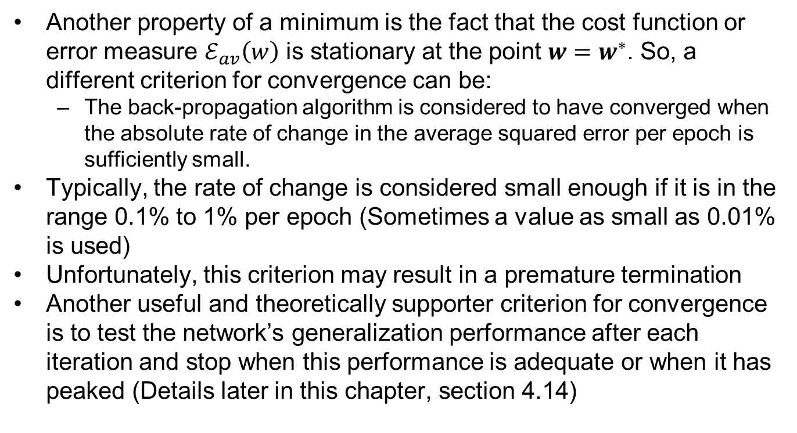
Back-Propagation Algorithm Stopping Criteria
Another property of a minimum is the fact that the cost function or error measure $ℰ_{av}\left(w\right)$ is stationary at the point $w=w^{∗}$. So, a different criterion for convergence can be:
The back-propagation algorithm is considered to have converged when the absolute rate of change in the average squared error per epoch is sufficiently small.
Typically, the rate of change is considered small enough if it is in the range 0.1% to 1% per epoch (Sometimes a value as small as 0.01% is used)
Unfortunately, this criterion may result in a premature termination
Another useful and theoretically supporter criterion for convergence is to test the network’s generalization performance after each iteration and stop when this performance is adequate or when it has peaked (Details later in this chapter, section 4.14)

Slide 28
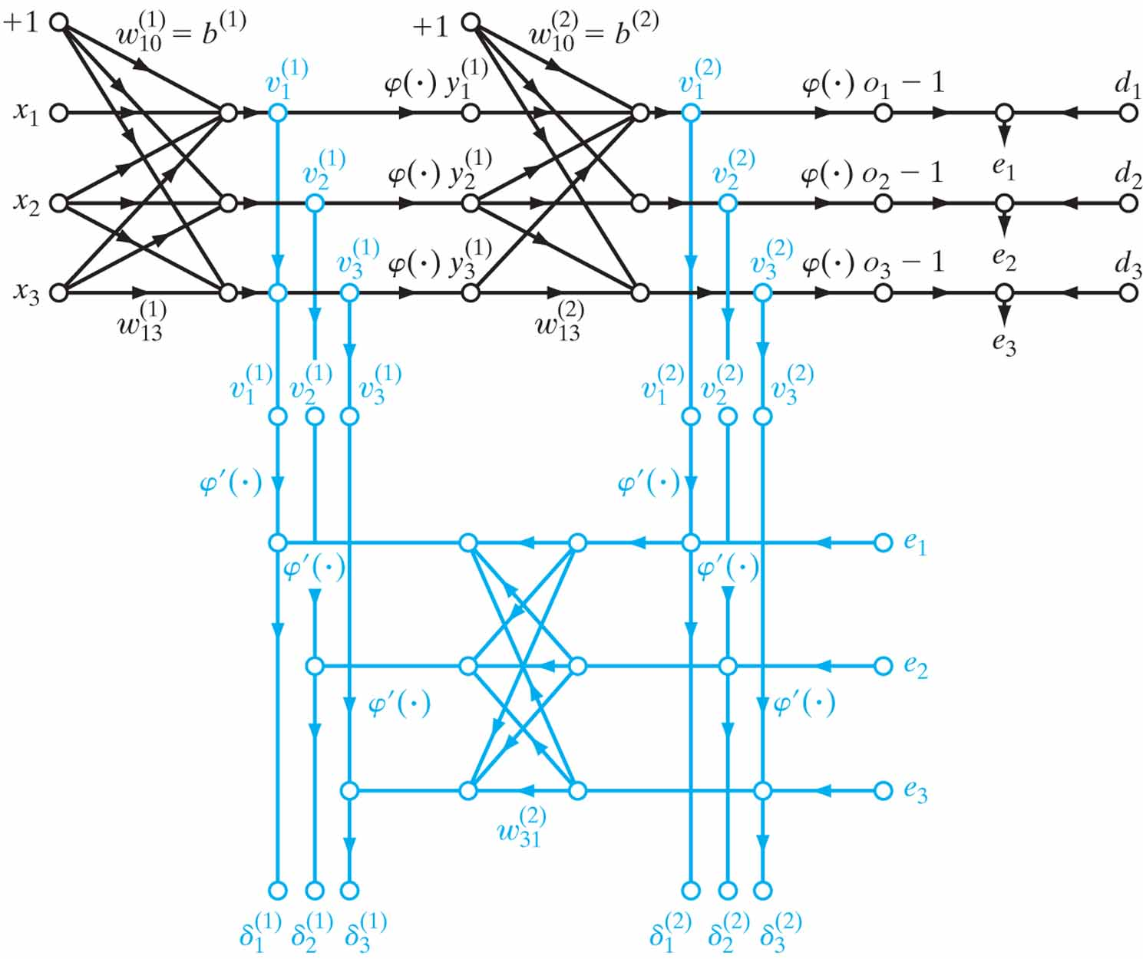
Back-Propagation Algorithm Summary
Figure 4.7 Signal-flow graphical summary of back-propagation learning. Top part of the graph: forward pass. Bottom part of the graph: backward pass.

Slide 29
Back-Propagation Algorithm Summary
Sequential mode is generally preferred and for this mode, algorithm cycles through the samples as follows:
Initialization: (With no prior information) pick weights and thresholds from a uniform distribution with zero mean
Presentations of training samples: present the network with an epoch of training samples. For each sample perform forward and backward computations described in 3 and 4 below
Forward computation: using one sample’s input values, compute activation potentials and function results going forward layer by layer. Finally, compute the error signal at the outputs.
Backward computation: Compute the local gradients and adjust the weights with the generalized delta rule in a backwards fashion.
Iteration: Iterate 3 and 4 with new epochs until the stopping criterion is met.
Notes: order of training samples are randomized between epochs. Momentum and learning-rate parameter are typically adjusted (usually decreased) as the number of iterations increases.

Slide 30
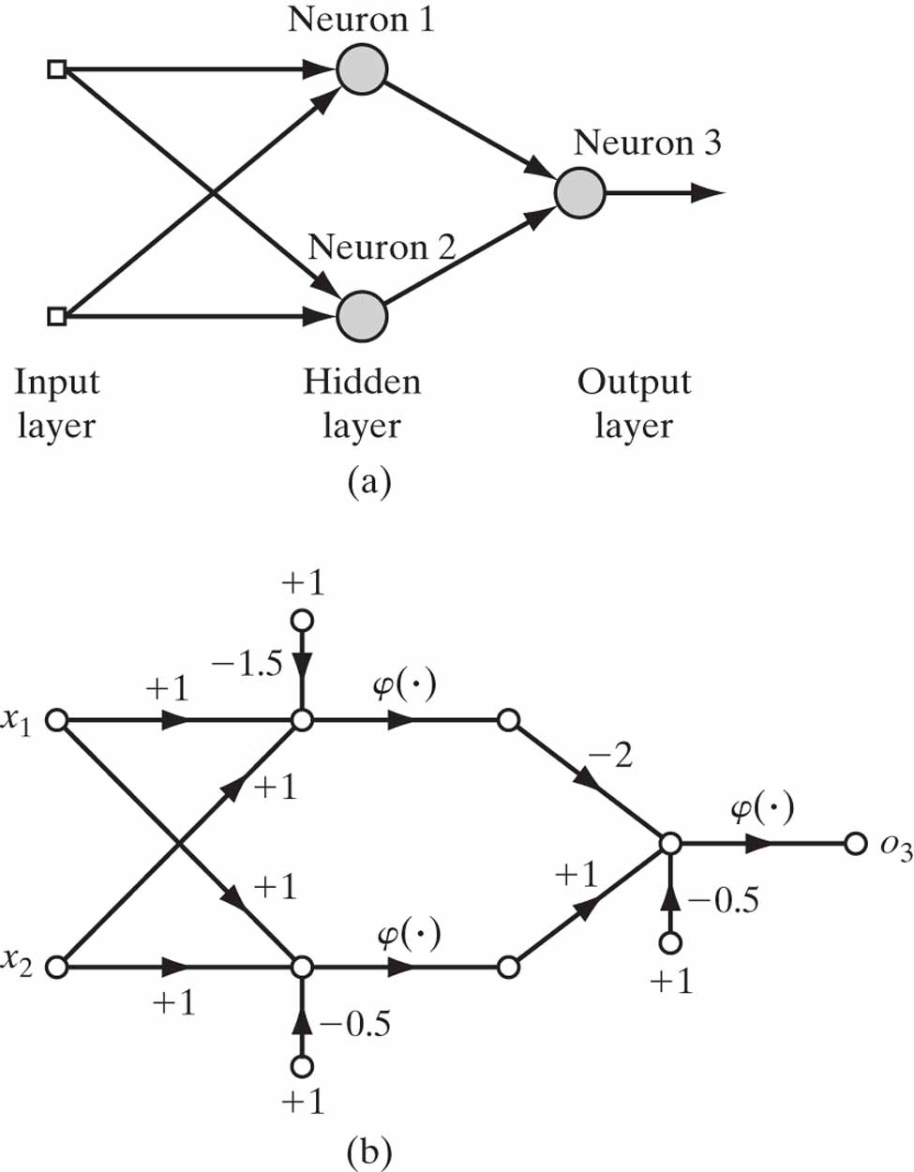
XOR Problem
A single-layer perceptron has no hidden layers and it can only classify linearly separable patterns.
Non-linearly separable patterns occur commonly. E.g. Exclusive OR problem
It can be solved by using a single hidden layer (a multilayer perceptron)

Slide 31
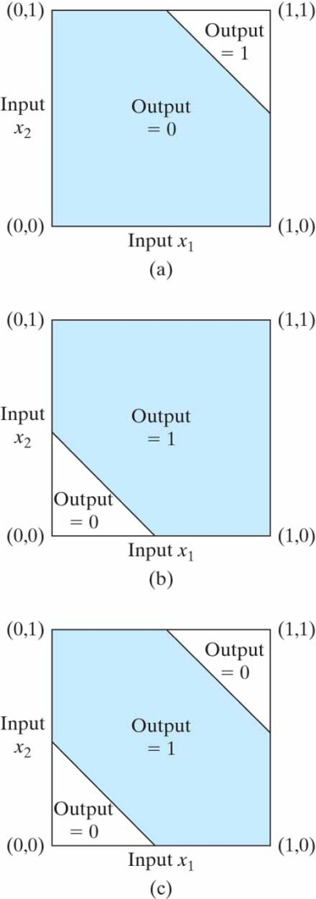
XOR Problem

Slide 32
Heuristics for Back-Propagation Alg.
Sequential vs. batch update: sequential mode is faster (especially true when training set is large and highly redundant)
Maximizing information content: Every training example presented to back-propagation alg. should ideally be chosen so that its information content is the largest possible for the task at hand.
Two ways to achieve this are:
Use an example that results in the largest training error
Use an example that is radically different from all those previously used
With sequential mode, a common simple method is to randomize (i.e., shuffle) the order of examples between epochs
A more refined technique (emphasizing scheme) is to present the network with more difficult examples. Whether an example is easy or difficult can be determined by the error it produces. 2 problems with this:
Example distribution within an epoch is distorted
An outlier, or mislabeled example is bad for the performance (learning these degrades the generalization ability of the network)

Slide 33
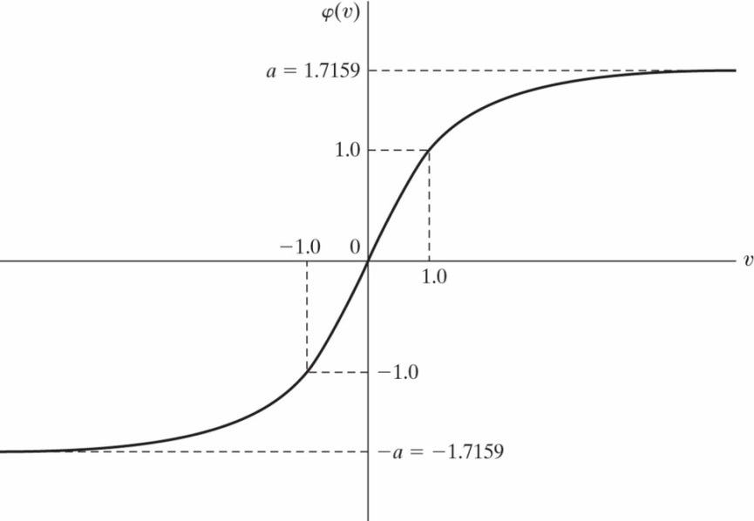
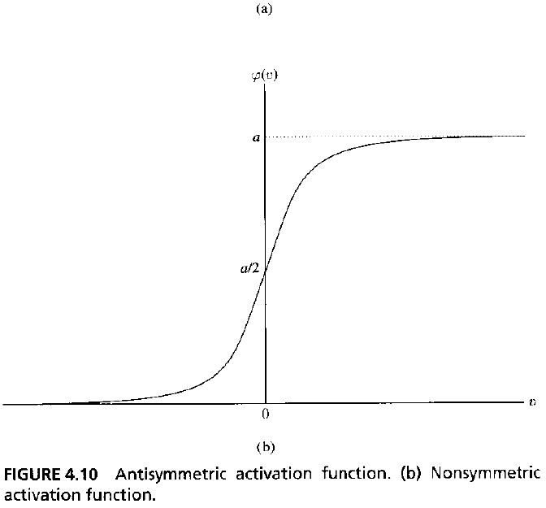
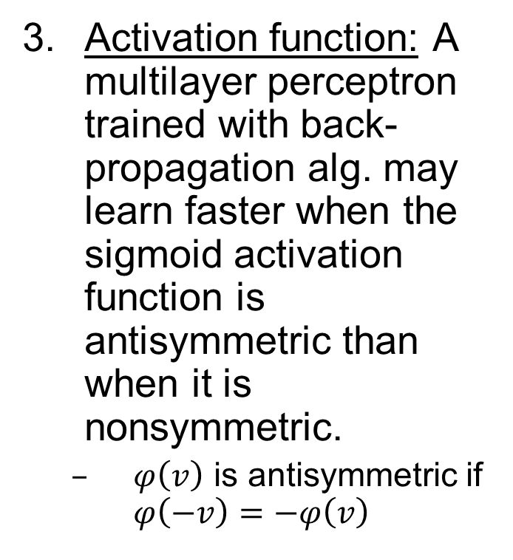
Heuristics for Back-Propagation Alg.
Activation function: A multilayer perceptron trained with back-propagation alg. may learn faster when the sigmoid activation function is antisymmetric than when it is nonsymmetric.
$φ\left(v\right)$ is antisymmetric if $φ\left(−v\right)=−φ\left(v\right)$

Slide 34
Heuristics for Back-Propagation Alg.
Target values: It is important that the target values (desired responses) are in the range of the sigmoid function.
These should be offset by some amount away from the limiting value.
Otherwise, back-prop. tends to drive the free parameters to infinity
Normalizing the inputs: Each input should be preprocessed so that its mean value (averaged over the entire training set) is close to zero. Also, 2 other measures accelerate back-propagation alg.
Input variables should be uncorrelated (can be done using Principal Component Analysis, Chapter 8)
Decorrelated input variables should be scaled so that their covariances are approximately equal (This ensures that different synaptic weights learn approximately at the same speed)

Slide 35
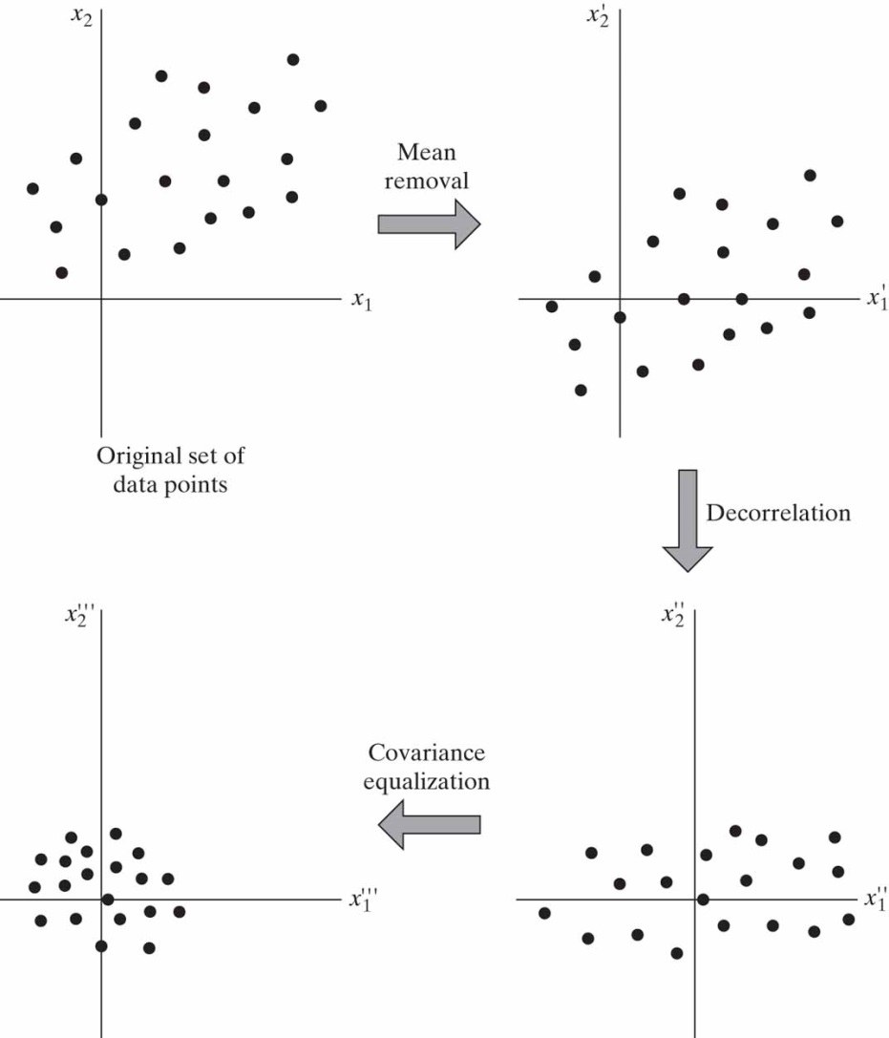
Heuristics for Back-Propagation Alg.

Slide 36
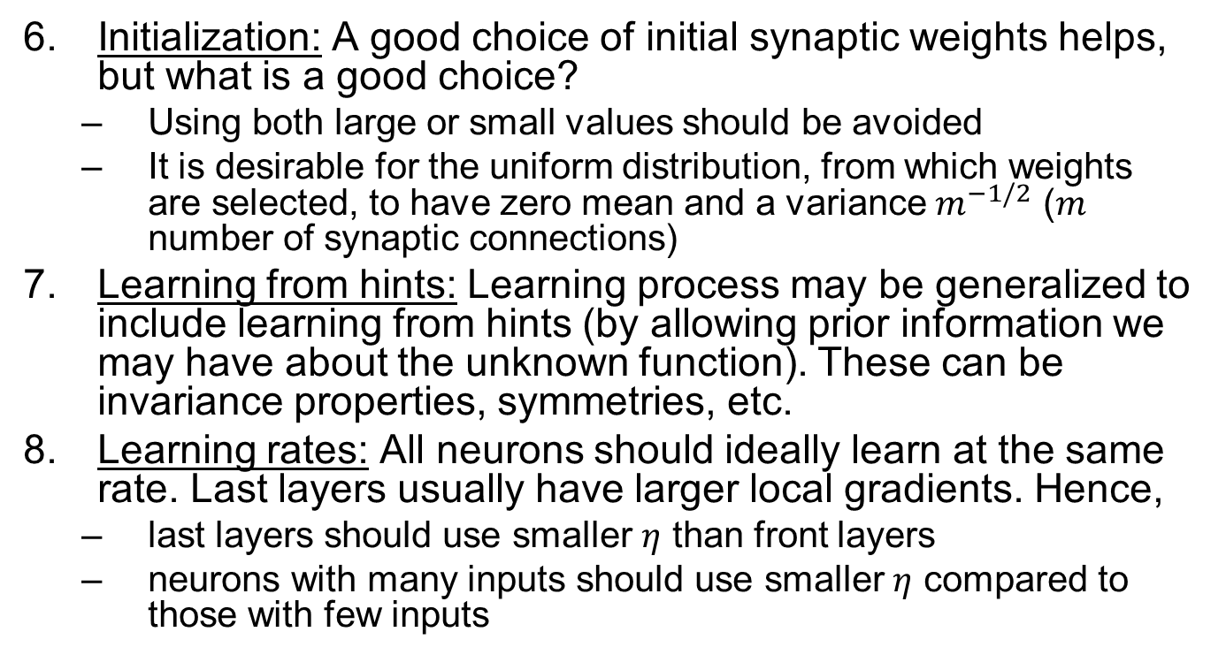
Heuristics for Back-Propagation Alg.
Initialization: A good choice of initial synaptic weights helps, but what is a good choice?
Using both large or small values should be avoided
It is desirable for the uniform distribution, from which weights are selected, to have zero mean and a variance $m^{−1/2}$ ($m$ number of synaptic connections)
Learning from hints: Learning process may be generalized to include learning from hints (by allowing prior information we may have about the unknown function). These can be invariance properties, symmetries, etc.
Learning rates: All neurons should ideally learn at the same rate. Last layers usually have larger local gradients. Hence,
last layers should use smaller $η$ than front layers
neurons with many inputs should use smaller $η$ compared to those with few inputs

Slide 37
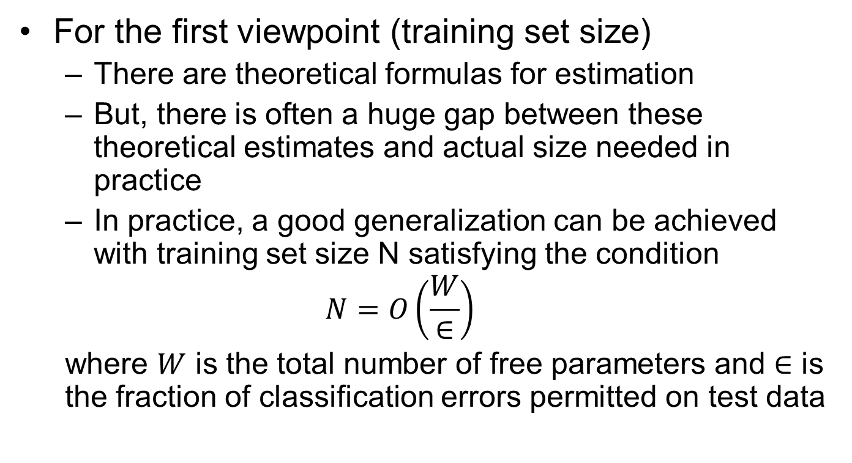
Generalizations
For the first viewpoint (training set size)
There are theoretical formulas for estimation
But, there is often a huge gap between these theoretical estimates and actual size needed in practice
In practice, a good generalization can be achieved with training set size N satisfying the condition
$$N=O\left(\frac{W}{∈}\right)$$
where $W$ is the total number of free parameters and $∈$ is the fraction of classification errors permitted on test data

